Slide 1


Natural Gas and Electricity Demand Forecasting by Sector in Singapore
Group 2
Student ID | Name | E-mail
A0178551X | Choo Ming Hui Raymond | E0267862@u.nus.edu
A0178431A | Huang Qingyi | E0267742@u.nus.edu
A0178415Y | Jiang Zhiyuan | E0267726@u.nus.edu
A0178365R | Wang Jingli | E0267676@u.nus.edu
A0178329R | Wong Yeng Fai, Edric | E0267640@u.nus.edu
A0178371X | Yang Shuting | E0267682@u.nus.edu

Slide 2
Natural Gas Part

Slide 3
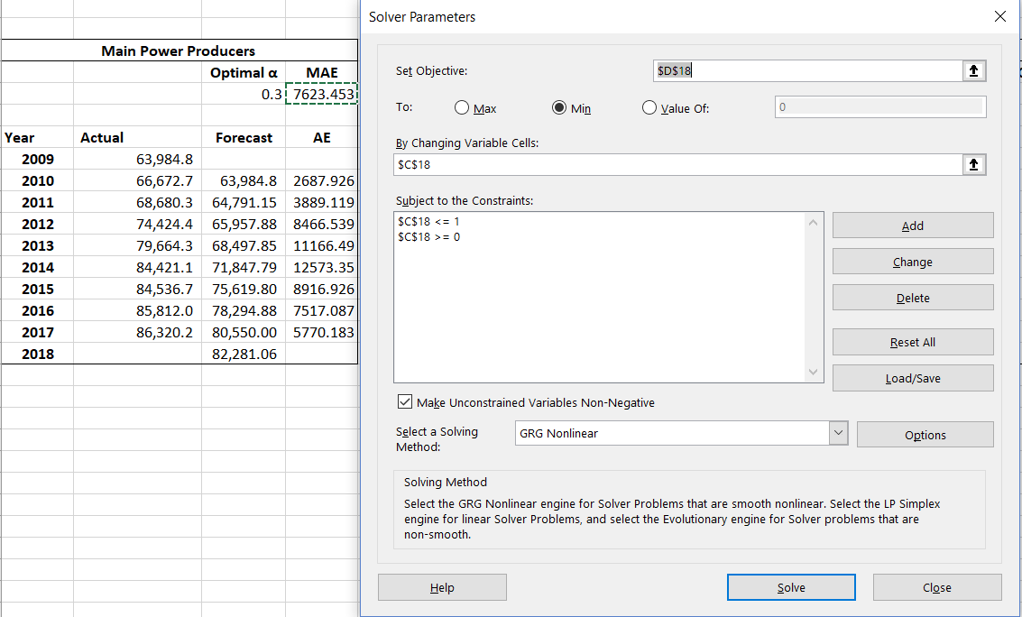
Project Requirement
Utilize various forecasting techniques for each sub sector to forecast and uncover insights.
Part I
Natural Gas
Part II
Electricity
Natural Gas Time Series Data Source:
Annual Detailed Natural Gas Balance Table (2009-2017)
Natural Gas Consumption by Sub-Sector (2009-2017)
Forecasting Objective:
Predict Period: 2018
To predict and compare the units of natural gas usage by sector using different techniques;
To analyse the trend of natural gas usage;
Forecasting Techniques:
Naïve Forecasting
Moving Average;
Exponential Smoothing;
Regression
Electricity Time Series Data Source:
Monthly Electricity Consumption by Sector (2005-2017)
Forecasting Objective:
Predict Period: 2018
To predict and compare electricity consumption by sector using different techniques;
Training Data: 2005-2016 (144); Validation Data: 2017 (12);
Forecasting Techniques:
(Seasonal) ARIMA;
Time Series Regression;
Double Exponential Smoothing;
Decomposition Methods;

Slide 4
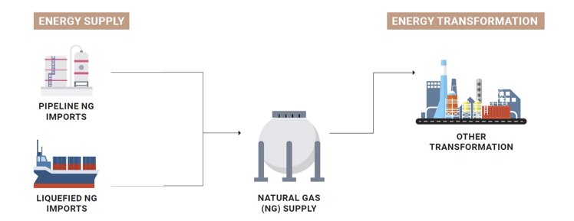








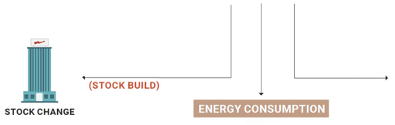









Natural Gas Supply and Demand Background
Manufacturing
Construction
Utilities
Other Industrial
-related
Wholesale and
Retail Trade
Accommodation
and Food Services
ENEGY CONSUMPTION
Information and Communications
Financial and Insurance Activities
ELECTRICITY GENERATION
Real Estate Activities
Professional, Scientific & Technical, Administration & Support Activities
Other Commerce and Services-related

Slide 5
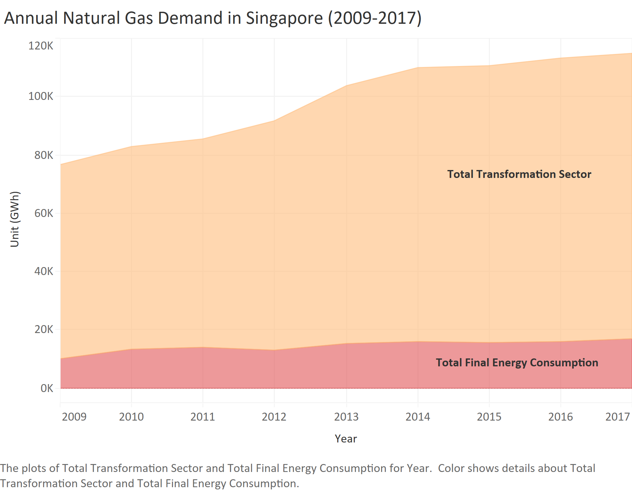
Current State of Natural Gas Demand
Natural Gas Time Series Data
Descriptive Analysis:
Total Primary Supply shows an increasing trend with a decelerated growth from 2014 to 2017;
Total Transformation shares nearly the same trend with the supply;
Total Final Energy consumption has a relatively gentle increasing trend.
Total Primary Supply
= Total Transformation Sector
+ Total Final Energy Consumption
+ Statistical Differences (SD)
~15%
Total Final Energy Consumption
~85%
Total
Transformation

Slide 6
Natural Gas Demand Forecast Summary
Summary:
The overall natural gas demand shows a gentle increasing trend;
Compared with all the time series prediction methods, based on the evaluation methods of minimizing the MAE, the regression forecasting performed best.
Most optimal α for Exponential Smoothing is equal to 1, the same as Naïve Forecasting, which might be due to the non-stationary data with considerable fluctuation and insufficient data points.
If the monthly or quarterly data was provided, the detailed natural gas demand seasonal and cycle characters insight by sub-sectors could also be discovered using appropriate time series forecasting methods;

Slide 7
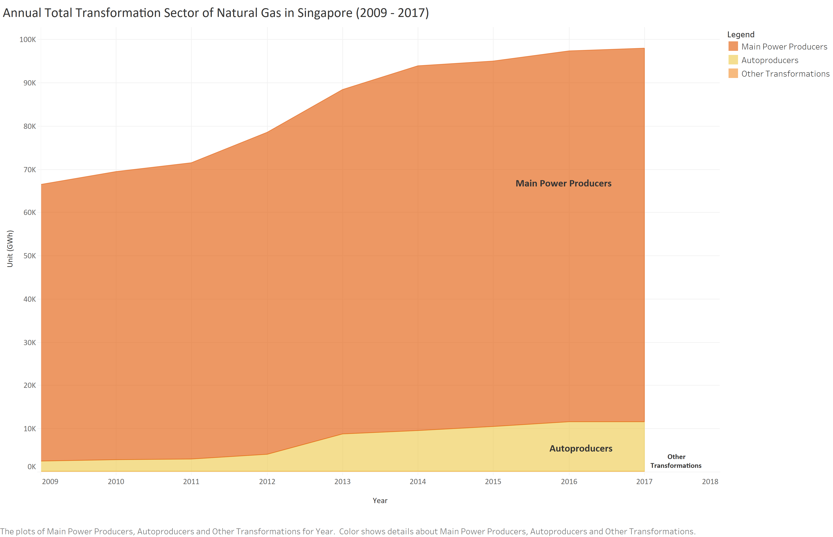
Transformation Sector Forecast
Main Producers
Autoproducers
Other Transformations
Transformation
Natural Gas Total Transformation Sector is mainly divided into two parts: Electricity Generation (Main Power Producers and Autoproducers) and Others.
Total Transformation Sector
= Electricity Generation (Main Power
Producers + Autoproducers)
+ Other Transformations
Current State of Total Transformation Sector Demand:
On average, more than 96% of the total transformation sector is used for electricity generation;
Main Power Producers account for more than 88% of the total electricity generated;
While the total Electricity Generated is increasing, there is an increasing contribution of Autoproducers in Electricity Generation, with a more than double increase observed in 2013;
Both Main Power Producers and Autoproducers experienced a decelerated growth from 2014 to 2017;

Slide 8


Transformation Sector Forecast
Main Producers
Autoproducers
Other Transformations
Transformation
The best forecasting techniques for all Transformation natural gas demand forecasting: Regression
$$F_{t}=β_{0}+β_{1}t$$
$$t:Index of Year$$
Total Transformation Sector of Natural Gas Usage Forecasting based on Regression:
Main Power Producers shares nearly the same increasing trend with the Total Transformation Sector, while Other Transformations decreases;
The coefficient of Main Power Producers is much more than Autoproducers, which demonstrates that the upward trend of the former one is more significant;
There’s a significant increase in natural gas usage by Autoproducers in 2013, which is more than double of that in 2012. This might be due to the ntry of new autoproducers, and existing autoproducers expanding their operations.
However, Other Transformations shows a gentle downward trend which might be due the rapid development of the electricity generation and efficiency.

Slide 9
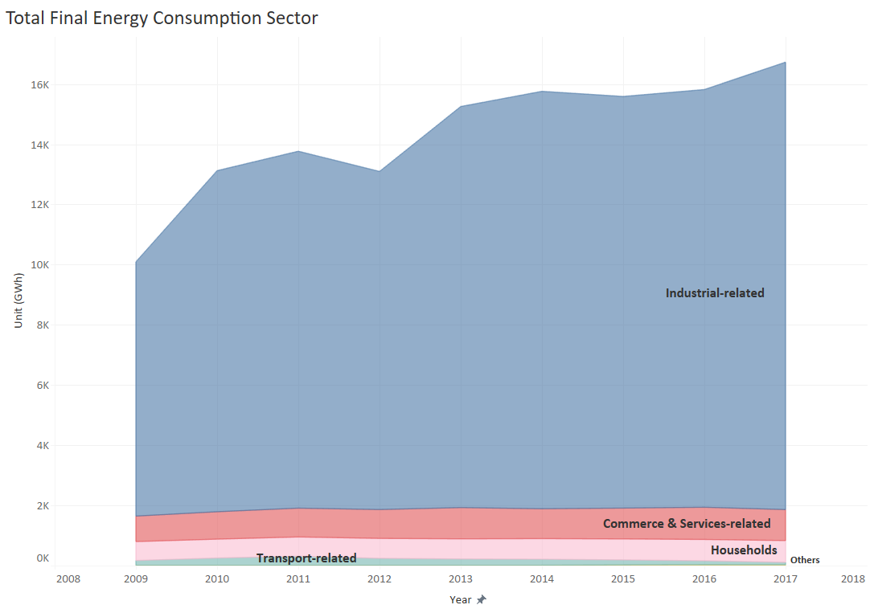
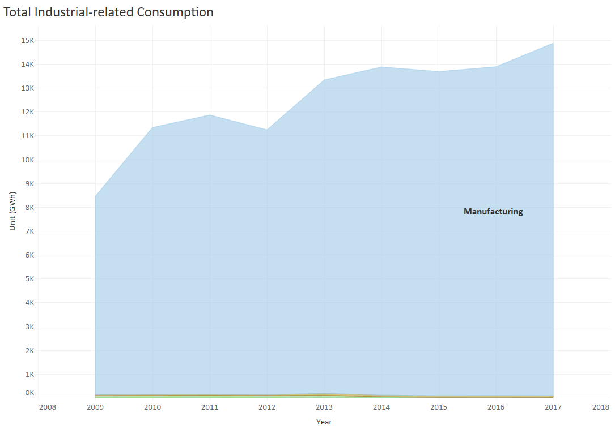
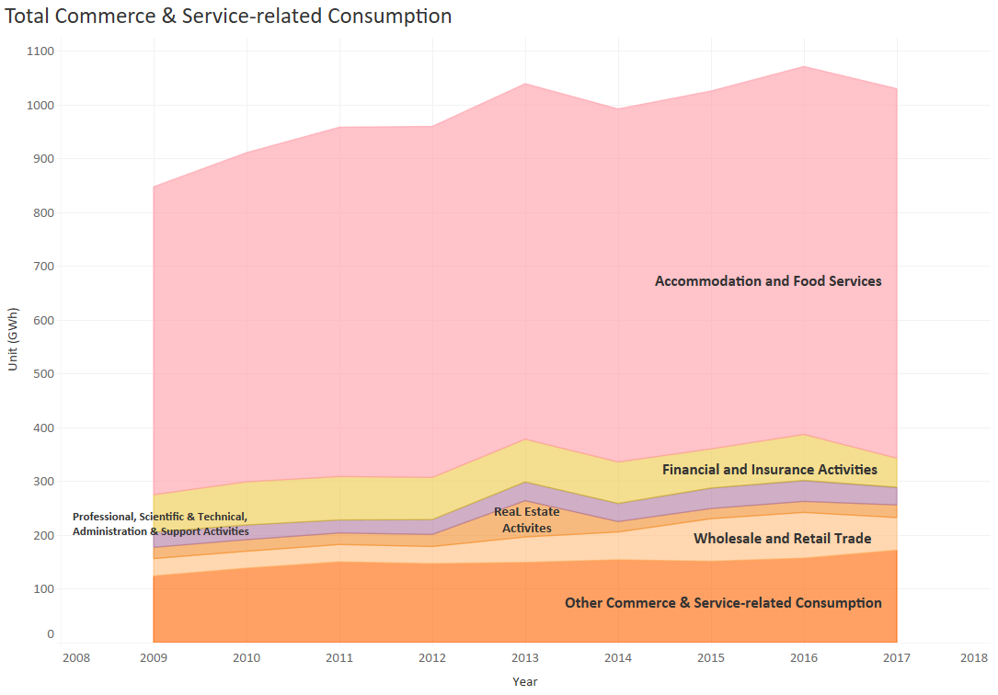
Consumption Sector Forecast
Industrial-related
Commerce and Service-related
Households
Transport-related
Others
Consumption
Natural gas total consumption sector is mainly divided into five parts: Industrial-related (4 sub-sectors), Commerce & Service-related (7 sub-sectors), Households, Transport-related and Others (All sort by proportion from large to small).
Total Consumption Sector of Natural Gas Current Status:
Industrial-related Sector accounts for more than 85% of the total consumption sector on average;
Commerce & Service-related and Household Sectors together account for around 12% of the total consumption sector;
Manufacturing sub-sector makes up of nearly 100% of the Industrial-related Sector while the Accommodation and Food Services Sub Sector makes up of around 66% of the Commerce & Service Sector;
Almost all the sectors shows a general upward trends except for the Transport-related sector.

Slide 10
Consumption Sector Forecast
Industrial-related
Commerce and Service-related
Households
Transport-related
Others
Consumption
The best forecasting techniques for all Industrial-related natural gas demand forecast: Regression
$$F_{t}=β_{0}+β_{1}t$$
$$t:Index of Year$$
Total Industrial-related Part of Natural Gas Consumption Forecasting based on Regression:
Manufacturing shares nearly the same trend of the gentle growth with the Total Industrial-related sub sector;
The coefficient of the Manufacturing model is much higher than others while only Utilities has a negative value. This demonstrates that the manufacturing industry developed very quickly whereas the public expenditure control for the utilities sub-sector is tightened;
Both two natural gas usage highpoints for construction and utilities in 2013 might be due to the increased growth in 2013, the year which the construction of the cross-island electricity transmission cable tunnels commenced in Singapore.

Slide 11
Consumption Sector Forecast
Industrial-related
Commerce and Service-related
Households
Transport-related
Others
Consumption
The best forecasting techniques for all Commerce and Service-related natural gas demand forecasting: Regression
$$F_{t}=β_{0}+β_{1}t$$
$$t:Index of Year$$
Total Commerce &Service-related Part of Natural Gas Consumption Forecasting based on Regression:
The overall forecasting value of the Commerce & Services-related part is summed by the forecasted values of its 7 sub-sectors, which is relatively more stationary;
All most all the coefficients are positive except for the Financial and Insurance Activities.
Accommodation and Communications has the greatest increase among all the 7 sub-sectors.

Slide 12


Consumption Sector Forecast
Industrial-related
Commerce and Service-related
Households
Transport-related
Others
Consumption
The best forecasting techniques for all Commerce and Service-related natural gas demand forecasting: Regression
$$F_{t}=β_{0}+β_{1}t$$
$$t:Index of Year$$
*The recent 4 years data was used for prediction to achieve the significance
Wholesale and Retail Trade:
Based on the actual records of the natural gas consumption of Wholesale and Retail Trade, it was noted that there was a great increase since 2012 and a considerable decrease in 2017.
Financial and Insurance Activities:
Though there exists a evident drop in 2017, which could be interpreted that corresponding time series has fluctuation, while the long-term trend does not drop too much.
Real Estate Activities:
According to the actual records of the natural gas consumption of Real Estate Activities, it demonstrates that a great increase only in 2013.
Based on the classification of Real Estate Activities under the Singapore Standard Industrial Classification (SSIC) 2015, this increase is likely attributed to Real Estate Developers, operating of serviced apartments, food courts, coffee shops and eating houses.

Slide 13
Consumption Sector Forecast
Industrial-related
Commerce and Service-related
Households
Transport-related
Others
Consumption
The best forecasting techniques for all Commerce and Service-related natural gas demand forecasting: Regression
$$F_{t}=β_{0}+β_{1}t$$
$$t:Index of Year$$
Professional, Scientific & Technical, Administration & Support Activities:
Other Commerce and Services-related:
Both two share the similar trend of relatively gentle increase, which shows these industries has developed with steady and rapid trend.
Information and Communications:
This part accounts for very little among all the consumptions of natural gas, but its obvious growth also indicates that the information and communications industry is developing at a high speed.

Slide 14

Consumption Sector Forecast
Industrial-related
Commerce and Service-related
Households
Transport-related
Others
Consumption
The best forecasting techniques for Transport-related and Households natural gas demand forecasting: Regression
The best forecasting techniques for Others natural gas demand forecasting: Exponential Smoothing
$$F_{t}=β_{0}+β_{1}t$$
$$t:Index of Year$$
Transport-related:
Based on the actual records of the natural gas consumption of Transport-related, from 2011 on，there was a gradual decline reduction in it. It might be due to the decline in popularity of private CNG vehicles and energy usage efficiency improvements in this sub sector.
Households:
The natural gas consumption of households shows a sustained steady growth among these years. It might attribute to the steady growth of the population and living standard in Singapore.
Others:
Based on the actual records of the natural gas consumption of the Others Sub Sector, it’s seen that there is a spike in 2015, before reaching a peak in 2016 and declining in 2017.
The Others Sub Sector refers to sectors or activities not adequately defined in SSIC 2015. Since there is no visibility of the activities represented by this sub sector, it’s not possible to comment on the trends here.

Slide 15
Electricity Part

Slide 16
Project Requirement
Utilize various forecasting techniques for each sub sector to forecast and uncover insights.
Part I
Natural Gas
Part II
Electricity
Natural Gas Time Series Data Source:
Annual Detailed Natural Gas Balance Table (2009-2017)
Natural Gas Consumption by Sub-Sector (2009-2017)
Forecasting Objective:
Predict Period: 2018
To predict and compare the units of natural gas usage by sector using different techniques;
To analyse the trend of natural gas usage;
Forecasting Techniques:
Naïve Forecasting
Moving Average;
Exponential Smoothing;
Regression
Electricity Time Series Data Source:
Monthly Electricity Consumption by Sector (2005-2017)
Forecasting Objective:
Predict Period: 2018
To predict and compare electricity consumption by sector using different techniques;
Training Data: 2005-2016 (144); Validation Data: 2017 (12);
Forecasting Techniques:
(Seasonal) ARIMA;
Time Series Regression;
Double Exponential Smoothing;
Decomposition Methods;

Slide 17
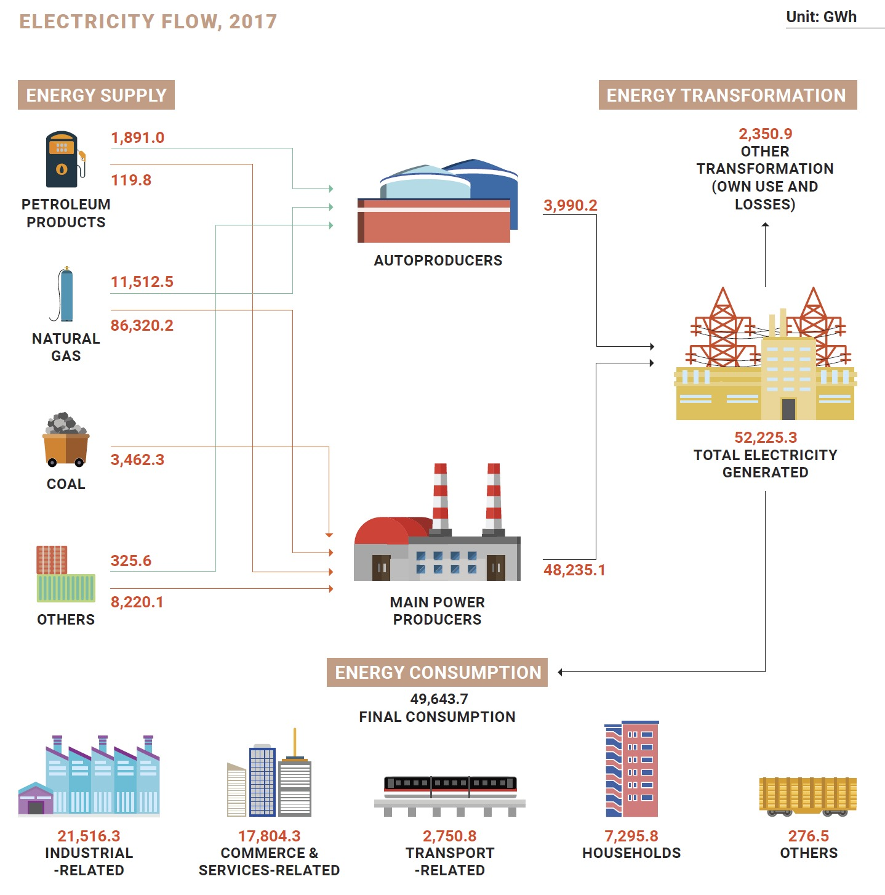
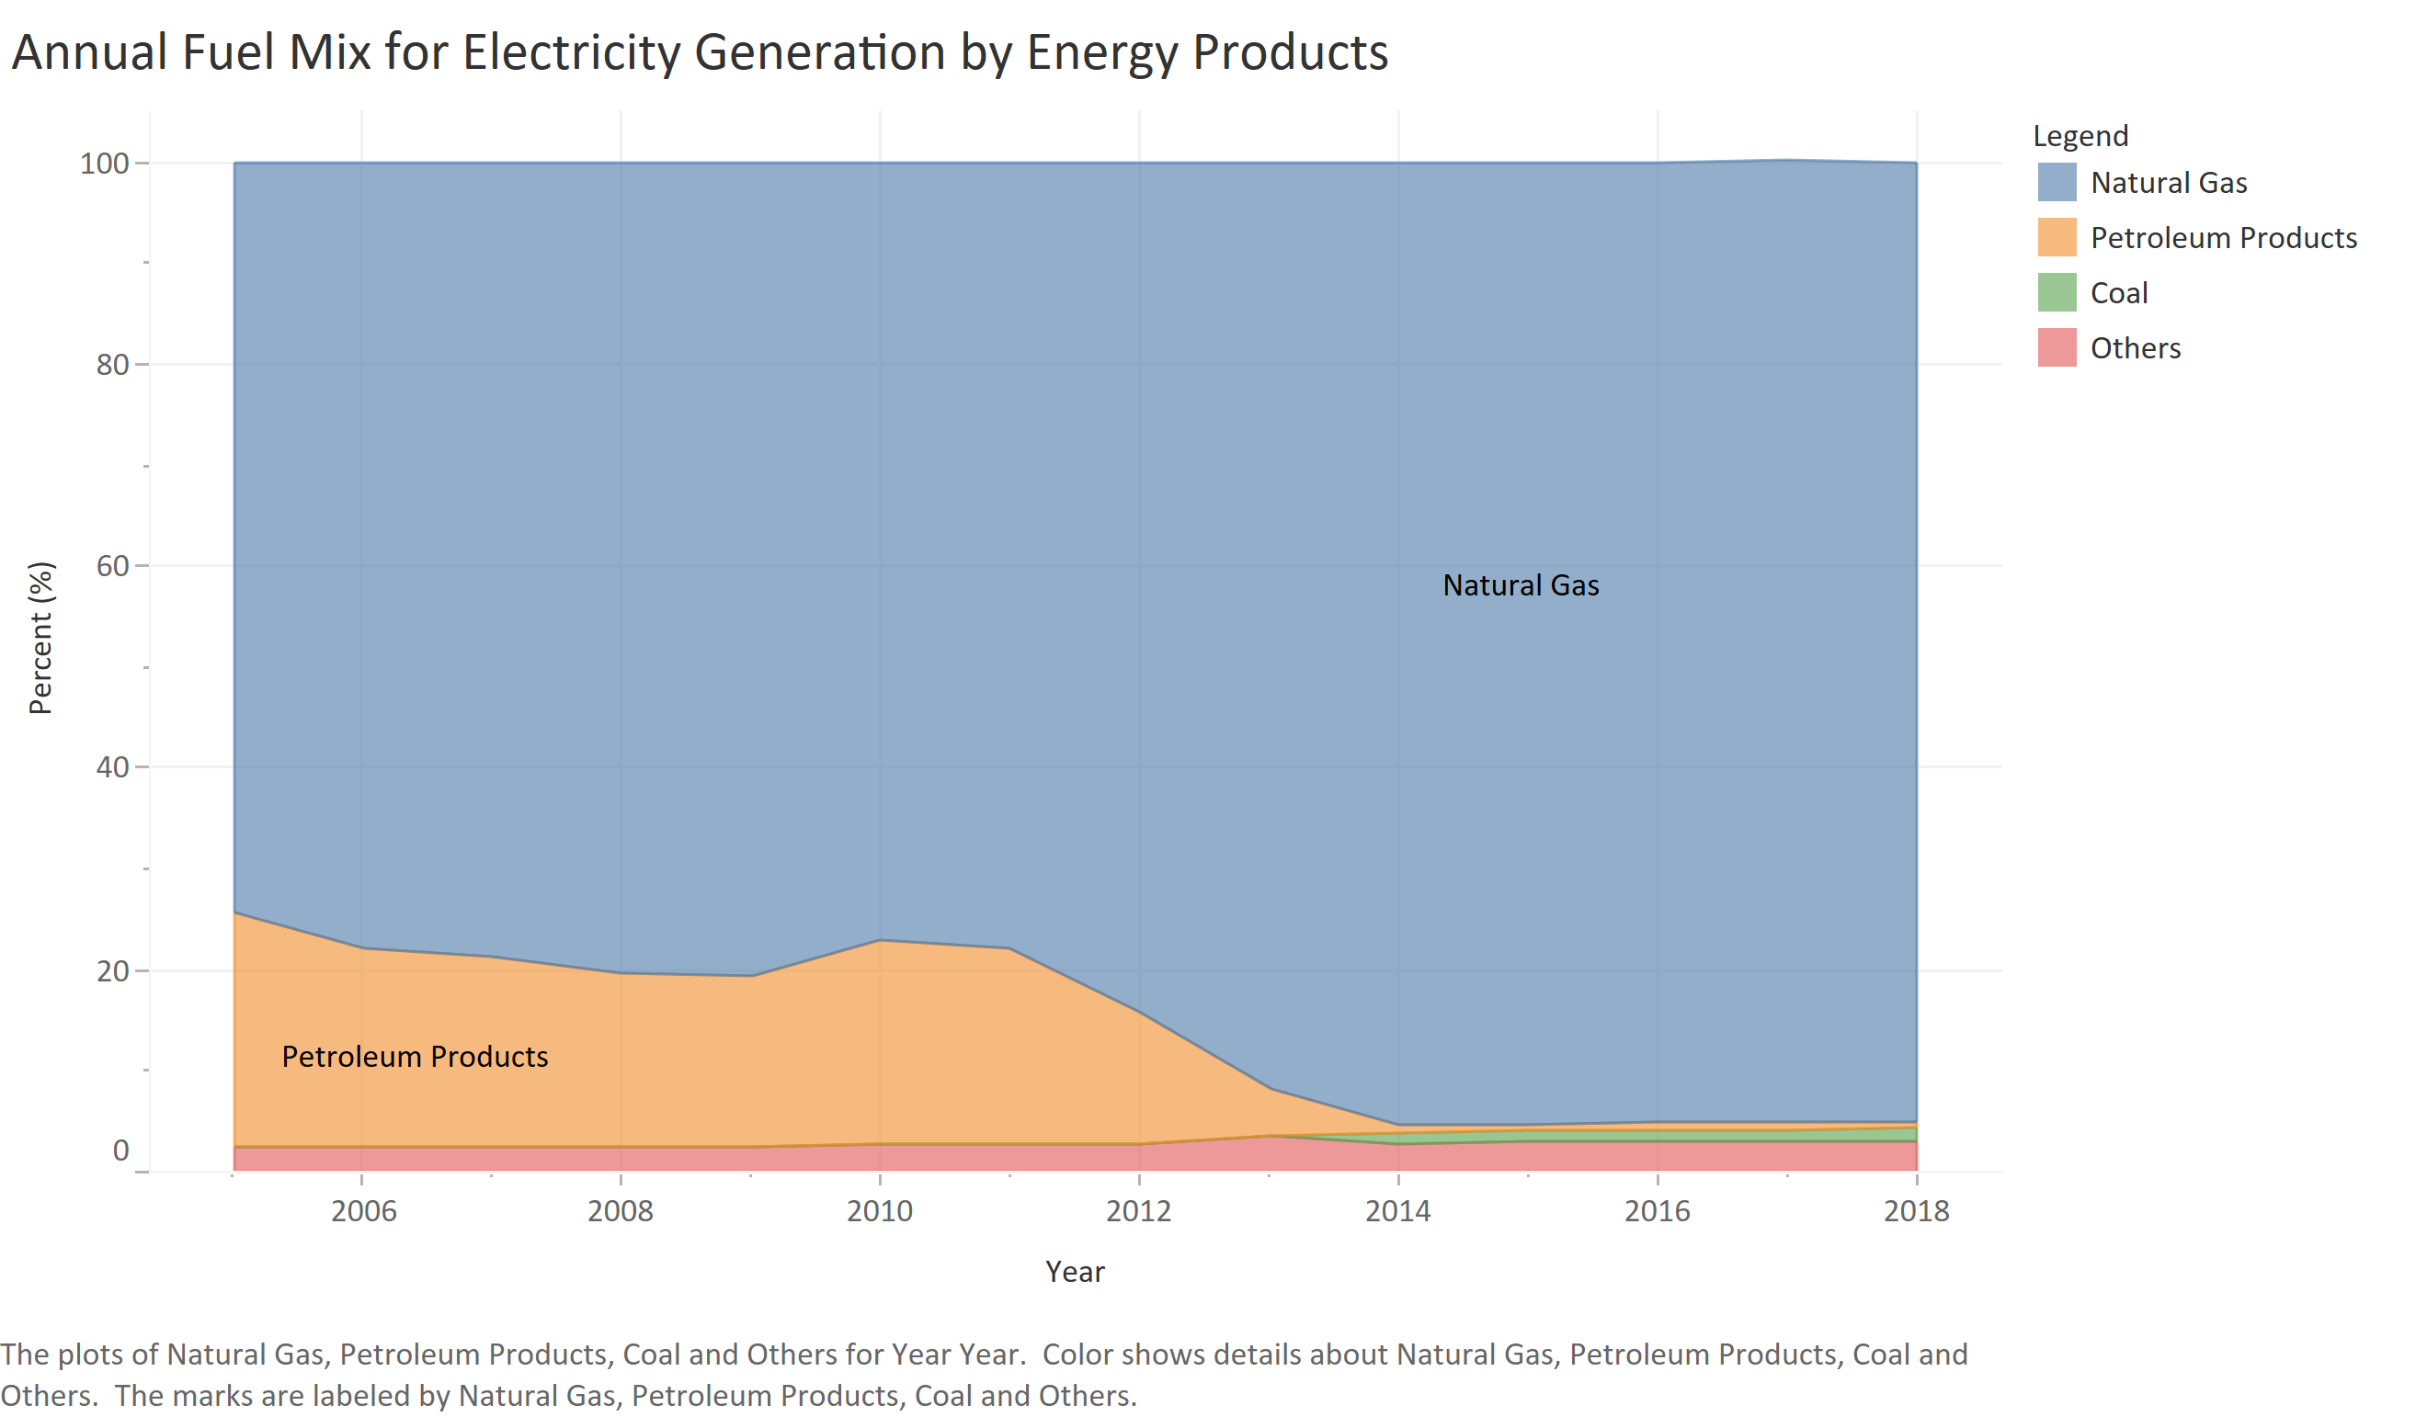
Background of Electricity Supply and Demand
Electricity Supply and Demand
Descriptive Analysis:
The main sectors of electricity supply are petroleum products, natural gas, coal and others while the natural gas accounts for more in the recent years. This is due to the introduction of new Combined Cycle Gas Turbine (CCGT) plants, resulting in a decline in dependence on steam turbine plants;
The main sectors of electricity demand are the five on the left, which the time series exploration would be executed as follows;

Slide 18
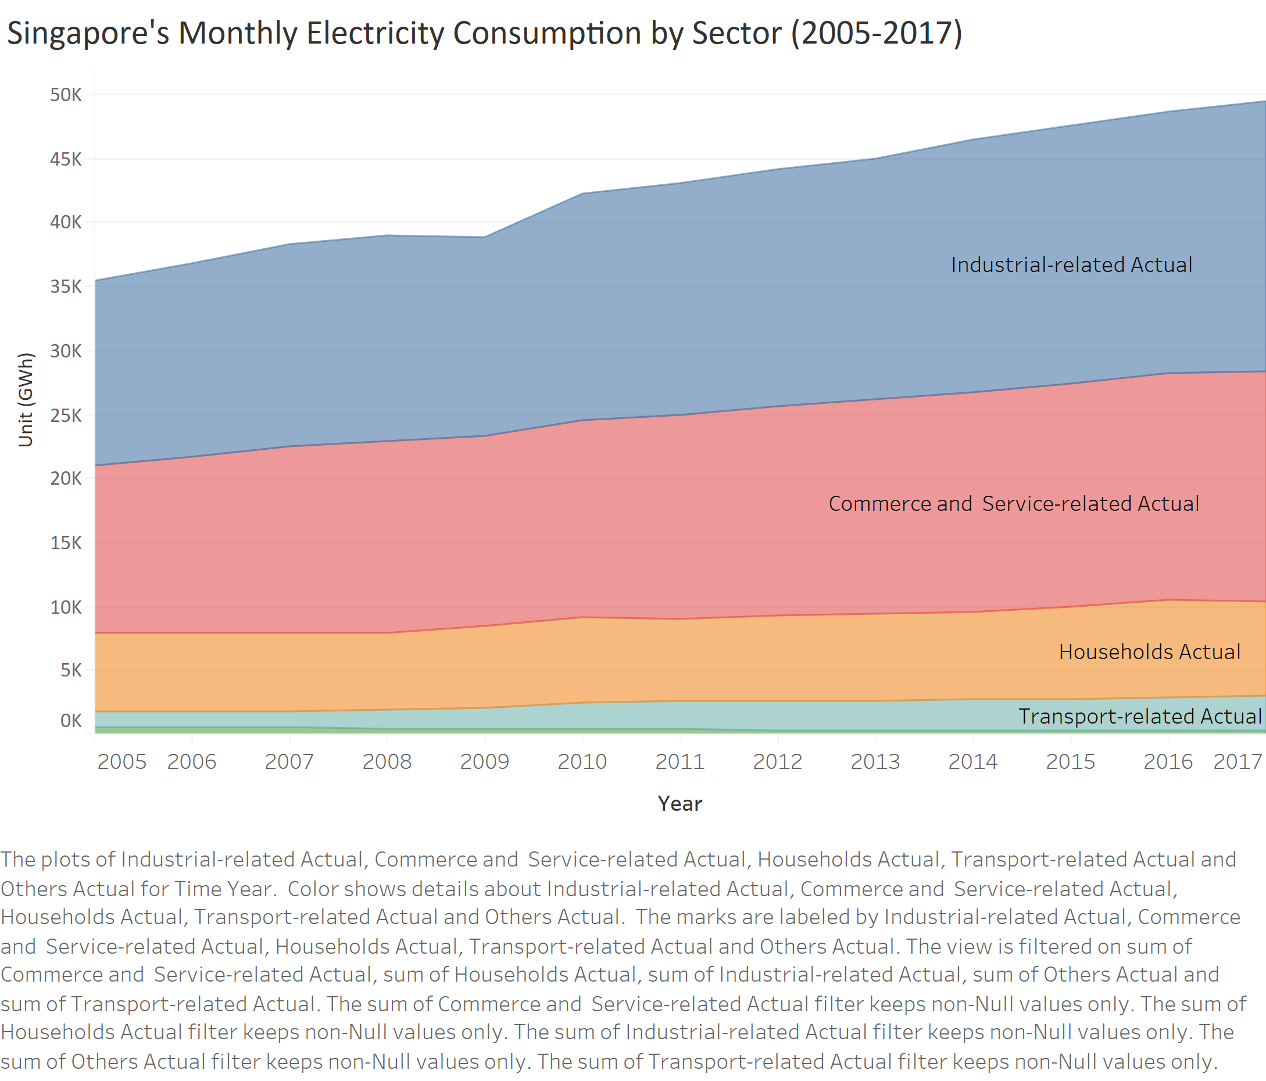
Current State of Electricity Demand
Electricity Time Series Data
Descriptive Analysis:
The electricity demand of all the sectors demonstrates an overall increasing trend;
The industrial-related and Commerce & Service-related Sectors are the top two largest electricity users, accounting for the similar share of the electricity demand, while the Households Sector follows closely behind.
Forecasting Methodology:
Four forecasting techniques comprising of (Seasonal) ARIMA, Time Series Regression, Double Exponential Smoothing, and the Decomposition Method were executed on each sector. The MAE was chosen as the evaluation method using 2017 as the validation data to compare and determine the best technique for each sector.
Accordingly, the total forecasted electricity demand in 2018 is then calculated by adding the best forecast for each sector.
The submitted excel spreadsheet contains the detailed results. Only the best results and their corresponding technique are illustrated in the following slides.
Total Electricity Demand
= Industrial-related
+ Commerce and Service-related
+ Transport-related
+ Households
+ Others

Slide 19
Electricity Demand Forecast Summary
June and August
March
Overall Electricity Demand Forecasting:
Combined with all the sectors values, the overall electricity demand increases steadily by year with the seasonality of 12 months;
The regular on-peak demand for electricity is around June and August while the off-peak demand is around March of each year;
As shown in the chart, the forecast for March, June and August in 2018 is 4004.51 GWh, 4386.89 GWh and 4557.43 GWh respectively.

Slide 20
Electricity Demand Forecast
Industrial-related
Commerce and Service-related
Households
Transport-related
Others
The best forecasting technique for Industrial-related electricity demand forecasting: Time Series Regression
$$F_{t}=1158.762821+3.868299756∗t+30.7513∗dummy1−5.62469∗dummy2−83.5776∗dummy3−21.7464∗dummy4+5.0627∗dummy5+52.2252∗dummy6+38.68∗dummy7+75.7117∗dummy8+51.2203∗dummy9+26.552∗dummy10+46.5221∗dummy11$$
August
March
Industrial-related Electricity Demand Forecasting:
The overall Industrial-related electricity demand increased steadily year on year with a seasonality of 12 months;
The regular on-peak demand for electricity is around August while the off-peak demand is around March of each year;
As shown in the chart, the forecast for March and August in 2018 is 1690.24 GWh and 1947.77 GWh respectively.

Slide 21
Electricity Demand Forecast
Industrial-related
Commerce and Service-related
Households
Transport-related
Others
The best forecasting technique for Commerce and Service-related electricity demand forecasting: Time Series Regression
$$F_{t}=1087.761+2.7544∗t−27.4246∗dummy1−38.24824∗dummy2−34.9257∗dummy3+13.266∗dummy4+25.027∗dummy5+58.11875∗dummy6+29.69511∗dummy7+68.39455∗dummy8+28.63245∗dummy9+27.53958∗dummy10+41.20056∗dummy11$$
August
February
Commerce and Service-related Electricity Demand Forecasting:
The overall Commerce and Service-related electricity demand increased steadily by year, with a seasonality of 12 months;
The regular on-peak demand for electricity is around August while the off-peak demand is around February of each year;
As shown in the chart, the forecast for February and August in 2018 is 1484.61 GWh and 1670.35 GWh respectively.

Slide 22
Electricity Demand Forecast
Industrial-related
Commerce and Service-related
Households
Transport-related
Others
The best forecasting technique for Transport-related electricity demand forecasting: Time Series Regression
$$F_{t}=87.5548+0.9853∗t+1.4695∗dummy1−1.6005∗dummy2−10.0089∗dummy3+2.3596∗dummy4+1.5281∗dummy5+6.1736∗dummy6+2.3267∗dummy7+7.1952∗dummy8+6.4099∗dummy9+2.6707∗dummy10+7.6315∗dummy11$$
August & September
March
Transport-related Electricity Demand Forecasting:
The overall Transport-related electricity demand increased steadily year on year with a seasonality of 12 months;
The regular on-peak demand for electricity is around August and September while the off-peak demand is around March of each year;
A considerable increase occurred from Aug 2009 to Oct 2009 (circled in red). This could be due to the vigorous development of public transport.
As shown in the chart, the forecast for March, August and September in 2018 is 234.21 GWh,256.35 GWh and 256.55 GWh respectively.

Slide 23
Electricity Demand Forecast
Industrial-related
Commerce and Service-related
Households
Transport-related
Others
The best forecasting technique for Households electricity demand forecasting: Time Series Regression
$$F_{t}=461.2641 +0.8388∗t−21.804∗dummy1−33.112∗dummy2−27.7508∗dummy3+26.6181∗dummy4+53.1562∗dummy5+81.4943∗dummy6+65.9786∗dummy7+57.2552∗dummy8+39.2471∗dummy9+36.6853∗dummy10+44.9234∗dummy11$$
June
February
Households Electricity Demand Forecasting:
The overall Households electricity demand increased steadily year on year with the seasonality of 12 months;
The regular on-peak demand for electricity is around June while the off-peak demand is around February of each year;
As shown in the chart, the forecast for February and June in 2018 is 560.68 GWh and 678.64 GWh respectively.

Slide 24
Electricity Demand Forecast
Industrial-related
Commerce and Service-related
Households
Transport-related
Others
The best forecasting technique for Others electricity demand forecasting: Seasonal ARIMA (0, 1, 1)(1, 1, 1)12
June and August
March
Others Electricity Demand Forecasting:
From 2005 to 2013, there was a gradual decline reduction in the overall others electricity demand while there is an upward trend in the number since 2014 with the seasonality of 12 months and the forecasted values maintain similar values seen in 2017;
The on-peak demand for electricity is around June and August while the off-peak demand is around March of each year.
As shown in the chart, the forecast for March, June and August in 2018 is 22.39 GWh, 26.14 GWh and 26.88 GWh respectively.

Slide 25
Appendix

Slide 26
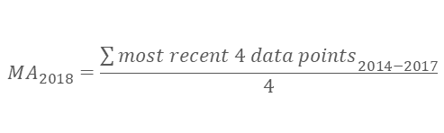
Transformation Sector Forecast
Transformation Data Plot by Sub-Sector
Naïve Forecasting
Moving Average
Regression
Exponential Smoothing
Due to the limited data available, seasonality across the years cannot be explored. A prediction for 2018 was performed using the following prediction methods:
According to the different trends of natural gas usage in different sub-sectors, the forecasting value of the part with sub-sectors is summed by each sub-sector forecasting value, e.g. F(Electricity Generation) = F(Main Power Producers) + F(Autoproducers)
Naïve Forecasting
Moving Average;
Exponential Smoothing;
Regression;
Method 1: Naïve Forecasting
The Naive forecast = Most recent actual values of the variable.
Method 2: Moving Average
Based on the previous transformation data plot by sector, to avoid the effect of the extreme value in 2013, the most recent 4 data points are used:
$${MA}_{2018}=\frac{{\sum{most recent 4 data points}}_{2014−2017}}{4}$$

Slide 27

Transformation Sector Forecast
Transformation Data Plot by Sub-Sector
Naïve Forecasting
Moving Average
Regression
Exponential Smoothing
Method 3: Exponential Smoothing
To achieve accurate predictions of process output, the optimal α is determined by minimizing the Mean Absolute Error (MAE) using “Data Solver” in Excel.
$$F_{t}=F_{t−1}+α(A_{t−1}−F_{t−1})$$
Total Transformation Sector of Natural Gas Usage Forecasting based on Exponential Smoothing:
Main Power Producers shares nearly the same trend of the gentle growth with the Total Transformation Sector;
Both optimal α for Main Power Producers and Autoproducers are 1, which is the same as Naïve Forecasting. This demonstrates that the time series fluctuate greatly, and the long-term changes in a significant upward trend;
The optimal α of Other Transformations is 0.31, which could be interpreted that the corresponding time series has fluctuation, whereas the long-term trend does not have too much change.

Slide 28

Transformation Sector Forecast
Transformation Data Plot by Sub-Sector
Naïve Forecasting
Moving Average
Regression
Exponential Smoothing
Method 4: Regression
Time Series = Trend + seasonality + cycle + random noise. According to the limited original data, only trend regression models would be built to achieve accurate predictions of process output. The parameter used to evaluate model fit is Mean Absolute Error (MAE).
$$F_{t}=β_{0}+β_{1}t$$
$$t:Index of Year$$
Total Transformation Sector of Natural Gas Usage Forecasting based on Regression:
Main Power Producers shares nearly the same increasing trend with the Total Transformation Sector, while Other Transformations decreases;
The coefficient of Main Power Producers is much more than Autoproducers, which demonstrates that the upward trend of the former is more significant;
There’s a significant increase in natural gas usage by Autoproducers in 2013, which is more than double of that in 2012. This might be due to the entry of new autoproducers, and existing autoproducers expanding their operations.
However, Other Transformations shows a gentle downward trend which might be due the rapid development of the electricity generation and efficiency.

Slide 29
Consumption Sector Forecast
Consumption Data Plot by Sub-Sector
Naïve Forecasting
Moving Average
Regression
Exponential Smoothing
Due to the limited data available, seasonality across the years cannot be explored. A prediction for 2018 was performed using the following prediction methods:
Naïve Forecasting
Moving Average;
Exponential Smoothing;
Regression;
Method 1: Naïve Forecasting
The Naive forecast = Most recent actual values of the variable.

Slide 30
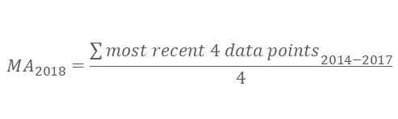
Consumption Sector Forecast
Consumption Data Plot by Sub-Sector
Naïve Forecasting
Moving Average
Regression
Exponential Smoothing
Method 2: Moving Average
Based on the previous consumption data plot by sub-sector, to avoid the effect of the relatively extreme growth from 2012 to 2013, the most recent 4 data points are used:
$${MA}_{2018}=\frac{{\sum{most recent 4 data points}}_{2014−2017}}{4}$$

Slide 31

Consumption Sector Forecast
Consumption Data Plot by Sub-Sector
Naïve Forecasting
Moving Average
Regression
Exponential Smoothing
Method 3: Exponential Smoothing for All
To achieve accurate predictions of process output, the optimal α is determined by minimizing the Mean Absolute Error (MAE).
$$F_{t}=F_{t−1}+α(A_{t−1}−F_{t−1})$$

Slide 32
Consumption Sector Forecast
Consumption Data Plot by Sub-Sector
Naïve Forecasting
Moving Average
Regression
Exponential Smoothing
Method 3.1: Exponential Smoothing for Industrial-related Sub Sector
To achieve accurate predictions of process output, the optimal α is determined by minimizing the Mean Absolute Error (MAE).
$$F_{t}=F_{t−1}+α(A_{t−1}−F_{t−1})$$
Total Industrial-related Part of Natural Gas Consumption Forecasting based on Exponential Smoothing:
Manufacturing shares nearly the same trend of the gentle growth with the Total Industrial-related Sub Sector;
The optimal α of Manufacturing, Utilities and Other Industrial related are 1, which are the same as Naïve Forecasting. It demonstrates that the corresponding time series fluctuate greatly, and the long-term changes in a significant trend;
The optimal α of Construction is 0.77, which could be interpreted that corresponding time series has fluctuation, while the long-term trend shows a great change.
Both two natural gas usage highpoints for construction and utilities in 2013 might be due to the increased growth in 2013, the year which the construction of the cross-island electricity transmission cable tunnels commenced in Singapore.

Slide 33
Consumption Sector Forecast
Consumption Data Plot by Sub-Sector
Naïve Forecasting
Moving Average
Regression
Exponential Smoothing
Method 3.2: Exponential Smoothing for Commerce &Service-related Sub Sector
To achieve accurate predictions of process output, the optimal α is determined by minimizing the Mean Absolute Error (MAE).
$$F_{t}=F_{t−1}+α(A_{t−1}−F_{t−1})$$
Total Commerce &Service-related Part of Natural Gas Consumption Forecasting based on Exponential Smoothing:
The overall forecasting value of the Commerce & Services-related part is summed by the forecasted values of its 7 sub-sectors, which is relatively more stationary;
Accommodation and Food Service shows a significant increase from 2009 to 2011 possibly due to the development of travel service industry. This causes the data to be non-stationary, resulting in an optimal α of 1. The increasing trend is less in the recent 4 years.

Slide 34
Consumption Sector Forecast
Consumption Data Plot by Sub-Sector
Naïve Forecasting
Moving Average
Regression
Exponential Smoothing
Method 3.2: Exponential Smoothing for Commerce & Service-related Sub Sector
To achieve accurate predictions of process output, the optimal α is determined by minimizing the Mean Absolute Error (MAE).
$$F_{t}=F_{t−1}+α(A_{t−1}−F_{t−1})$$
Optimal α: 1
Optimal α: 0.55
Optimal α: 1
Wholesale and Retail Trade:
Based on the actual records of the natural gas consumption of Wholesale and Retail Trade, it was noted that there was a great increase since 2012 and a considerable decrease in 2017. This causes the whole data to be non-stationary, resulting in the prediction optimal α to be equal to 1, which is the same as the naïve forecast.
Financial and Insurance Activities:
Though there exists a evident drop in 2017, the optimal α of Other Financial and Insurance Activities is 0.55, which could be interpreted that corresponding time series has fluctuation, while the long-term trend does not have too much change.
Real Estate Activities:
According to the actual records of the natural gas consumption of Real Estate Activities, it demonstrates that a great increase only in 2013.
Based on the classification of Real Estate Activities under the Singapore Standard Industrial Classification (SSIC) 2015, this increase is likely attributed to Real Estate Developers, operating of serviced apartments, food courts, coffee shops and eating houses.

Slide 35
Consumption Sector Forecast
Consumption Data Plot by Sub-Sector
Naïve Forecasting
Moving Average
Regression
Exponential Smoothing
Method 3.2: Exponential Smoothing for Commerce & Service-related Sub Sector
To achieve accurate predictions of process output, the optimal α is determined by minimizing the Mean Absolute Error (MAE).
$$F_{t}=F_{t−1}+α(A_{t−1}−F_{t−1})$$
Optimal α: 0.88
Optimal α: 1
Optimal α: 0.85
Professional, Scientific & Technical, Administration & Support Activities:
Other Commerce and Services-related:
Both share the similar trend of relatively gentle increase, which shows these industries has developed with steady and rapid trend.
Information and Communications:
This part accounts for very little among all sub sectors of the consumption of natural gas, but its obvious growth also indicates that the Information and Communications industry is developing at a high speed.

Slide 36
Consumption Sector Forecast
Consumption Data Plot by Sub-Sector
Naïve Forecasting
Moving Average
Regression
Exponential Smoothing
Method 3.3: Exponential Smoothing for Transport-related, Households and Others Parts
To achieve accurate predictions of process output, the optimal α is determined by minimizing the Mean Absolute Error (MAE).
$$F_{t}=F_{t−1}+α(A_{t−1}−F_{t−1})$$
Optimal α: 1
Optimal α: 1
Optimal α: 1
Transport-related:
Based on the actual records of the natural gas consumption of Transport-related, there was a gradual decline since 2011, which made the data non-stationary and the prediction optimal α is equal to 1, the same as the naïve forecast. It might be due to the decline in popularity of private CNG vehicles and energy usage efficiency improvements in this sub sector.
Households:
The natural gas consumption of households shows a sustained steady growth among these years. It might attribute to the steady growth of the population and living standard in Singapore.
Others:
Based on the actual records of the natural gas consumption of the Others Sub Sector, it’s seen that there is a spike in 2015, before reaching a peak in 2016 and declining in 2017.
The Others Sub Sector refers to sectors or activities not adequately defined in SSIC 2015. Since there is no visibility of the activities represented by this sub sector, it’s not possible to comment on the trends here.

Slide 37
Consumption Sector Forecast
Consumption Data Plot by Sub-Sector
Naïve Forecasting
Moving Average
Regression
Exponential Smoothing
Method 4: Regression
Time Series = Trend + seasonality + cycle + random noise. According to the limited original data, only trend regression models would be built to achieve accurate predictions of process output. The parameter used to evaluate model fit is Mean Absolute Error (MAE).
$$F_{t}=β_{0}+β_{1}t$$
$$t:Index of Year$$

